Slide 1
Project Update (Group-4) Experimental Setup To Measure the L-I Characteristics of a LED
Bangladesh University of Engineering and Technology
Department of Electrical and Electronic Engineering
EEE 460 (July 2023) – Optoelectronics lab
Presentation Date: 11th February 2023
Presented by:
Ayenul Azim Student ID: 1806089
Shahriar Khan Student ID: 1806092
Presented by:
3. Saif Ahmed Sunny Student ID: 1806097
4. Shahriar Ahmed Student ID: 1806192

Slide 2
Outline
Summary
Introduction
Design
Implementation
Analysis and Evaluation
References

Slide 3
1. Summary / Abstract
Experiment to understand how voltage applied to an LED affects emitted light (current).
Uses Arduino to control voltage and measure current.
Analyses LED limitations: voltage for light emission and safe current level.
Creates an L-I curve (current vs voltage) for further LED behaviour analysis..

Slide 4
2. Introduction
LEDs are widely used for their efficiency and lifespan, but understanding their current vs voltage (L-I) behaviour is key.
This experiment builds a circuit to measure L-I using common components.
We'll map the L-I curve by varying voltage and measuring current.
The experiment will identify the forward voltage (light emission threshold) and maximum safe current.
This helps us understand how LEDs work and use them effectively.

Slide 5
3.1 Design: Problem Formulation (PO(b))
3.1.1 Identification of Scope
This experiment builds an automated system to measure LED properties.
It measures both electrical behaviour (I-V curve) and light output (L-I curve).
This avoids needing a separate light measuring device.
Initial calibration with a real light meter is needed for accurate results.

Slide 6
3.1 Design: Problem Formulation (PO(b))
3.1.2 Literature Review
Threshold voltage: minimum voltage to turn on an LED for noticeable light.
Varies by LED colour due to material differences.
Red LEDs: 1.7-2.0 volts
Green LEDs: 2.9-3.1 volts
Blue LEDs: 3.0-3.3 volts (higher energy needed for blue light)
Specific voltage may vary by manufacturer and model.

Slide 7
3.1 Design: Problem Formulation (PO(b))
3.1.3 Formulation of Problem
The main obstacle was how to design a circuit that can generate an output parameter that can be used to measure the current and output power of the LED that is taken for test by the circuit prototype

Slide 8
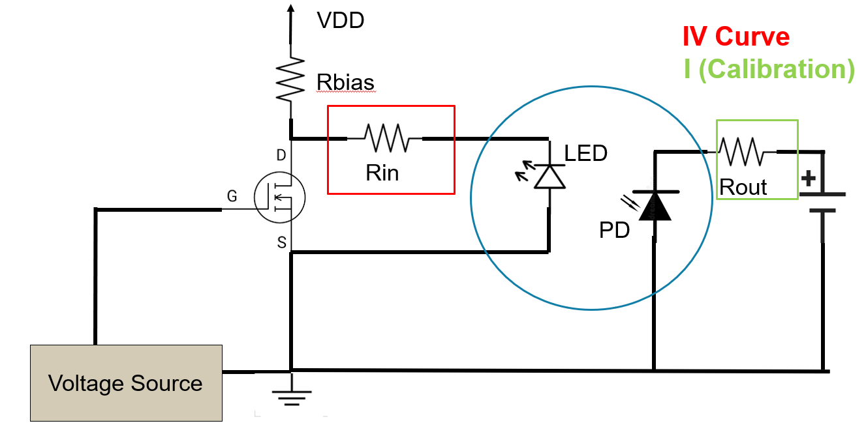
3.3 Design: Circuit Diagram
Circuit diagram of project

Slide 9
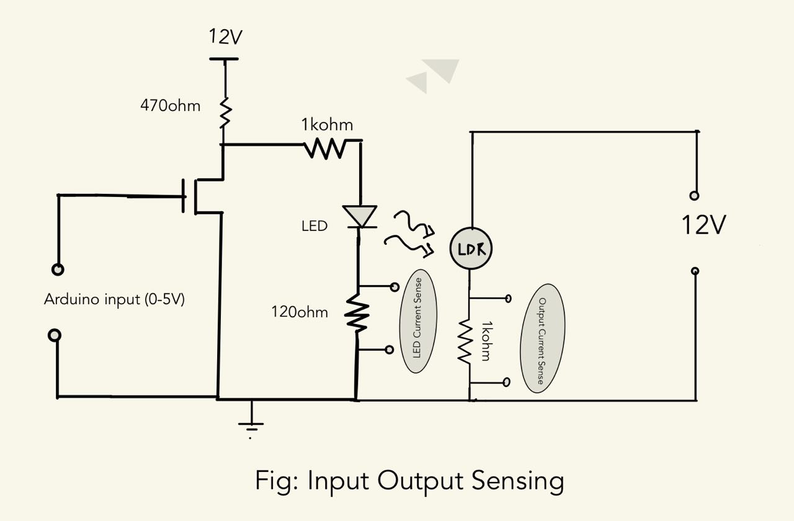
3.3 Design: Circuit Diagram
Circuit diagram of project

Slide 10
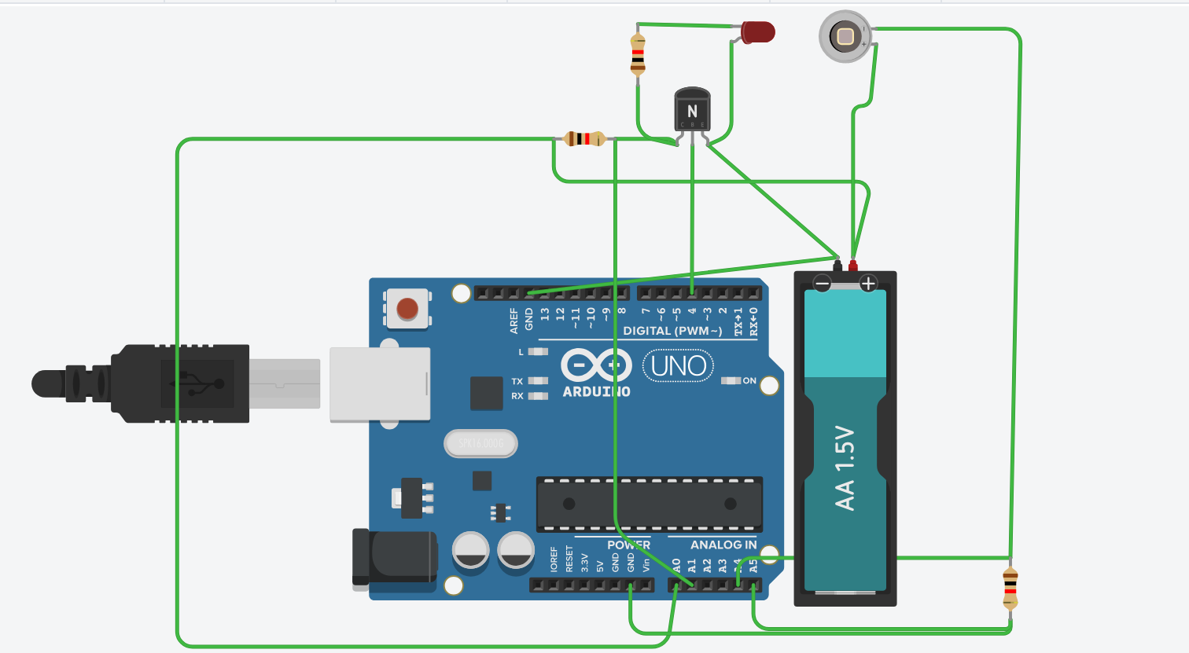
3.3 Design: Circuit Diagram
Circuit diagram of project

Slide 11
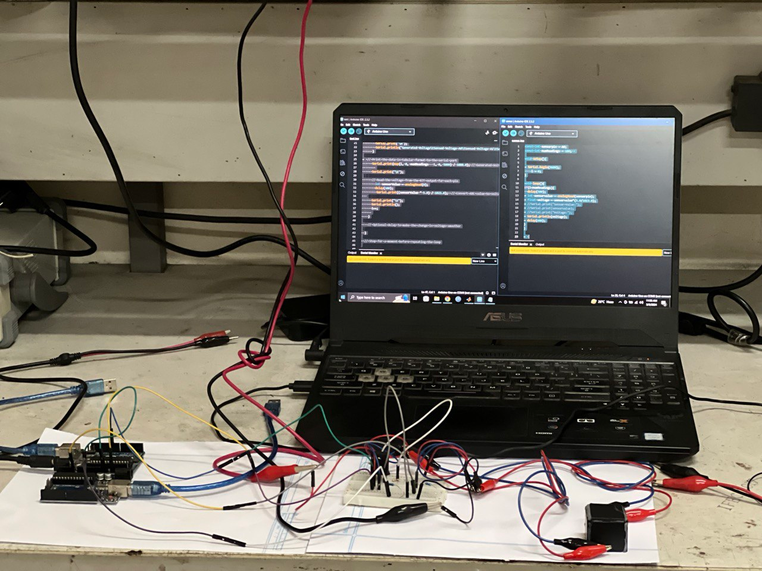
3.5 CAD/Hardware Design

Slide 12
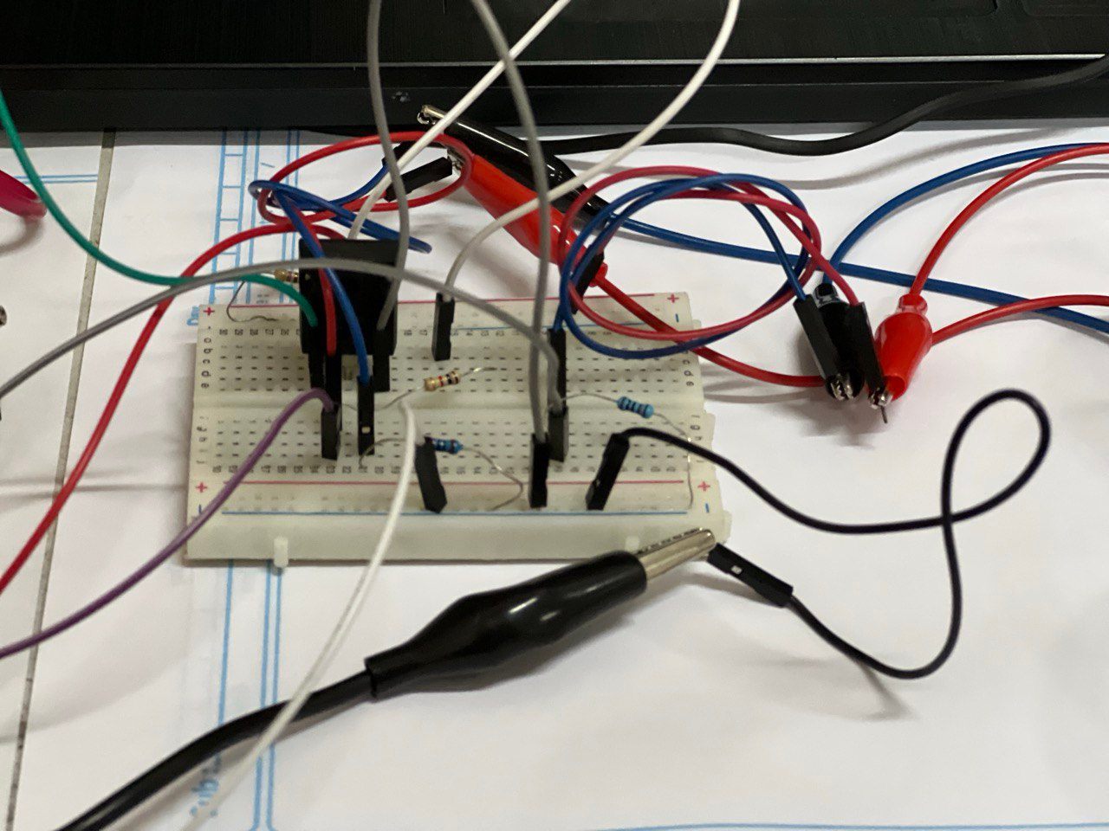
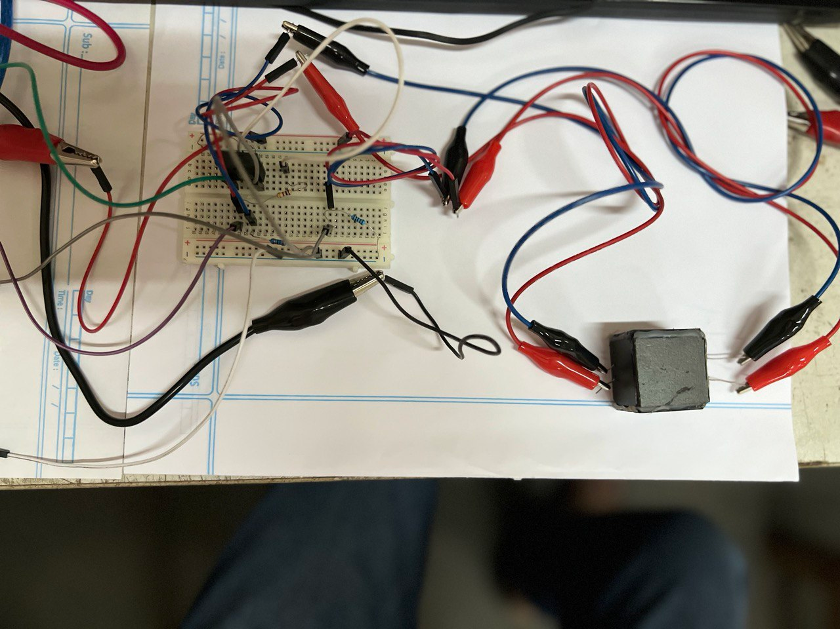
3.5 CAD/Hardware Design

Slide 13
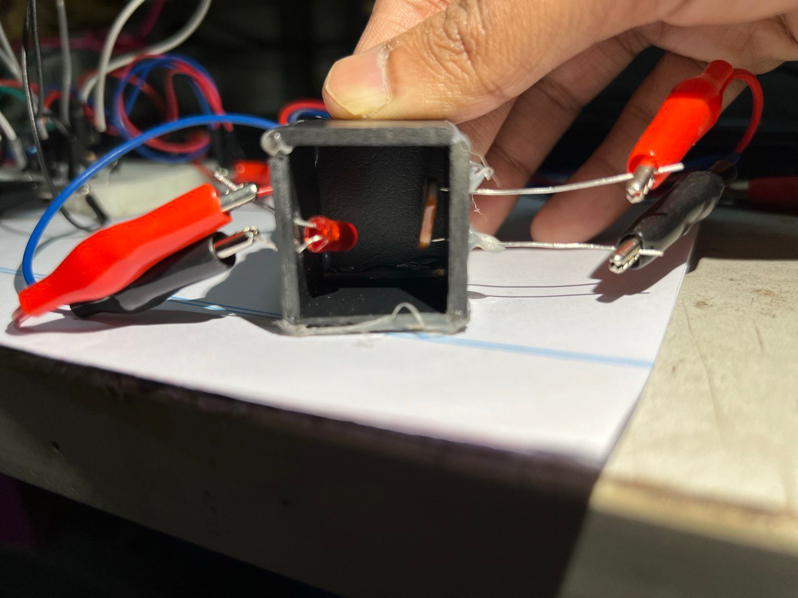
3.5 CAD/Hardware Design

Slide 14

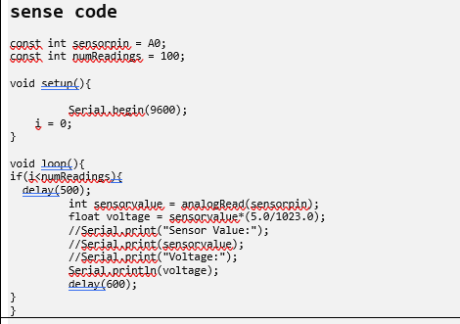
3.6 Arduino Code

Slide 15
5. Design Analysis and Evaluation
5.1 Novelty
5.2 Design Considerations (PO(c))
5.3 Investigations (PO(d))
5.4 Limitations of Tools (PO(e))
5.5 Impact Assessment (PO(f))
5.6 Sustainability and Envaronmental Impact Evaluation (PO(g))
5.7 Ethical Issues (PO(h))

Slide 16
5.1 Novelty
This experiment measures light output and current of colored LEDs without an optical power meter (new approach).
It uses a MOSFET to isolate the LED from the voltage source and provide enough current to light it fully.
This MOSFET also isolates the microcontroller from the LED's electrical properties.

Slide 17
5.2 Design Considerations (PO(c))
5.2.1 Considerations to public health and safety
5.2.2 Considerations to environment
5.2.3 Considerations to cultural and societal needs

Slide 18
5.2.1 Considerations to Environment
Measuring LED L-I characteristics has minimal environmental impact.
Main concern is the energy used during measurement.
Use energy-efficient power supplies and minimize experiment duration to reduce energy consumption.

Slide 19
5.2.2 Considerations to Safety Issues
Eye Safety: Proper safety precautions are crucial to prevent eye damage. Safety must be followed during experimentation.
Voltage source: Voltage source must be used carefully.
5.2.2 Considerations to Legal issues
Product Liability: Manufacturers and researchers must ensure that LEDs meet quality standards. Any defects or failures could lead to product liability claims.
Consumer Safety: LEDs used in commercial products (lighting, displays, etc.) must comply with safety regulations to prevent harm to consumers.

Slide 20
5.4 Design of Experiment
470ohm: Protects the circuit from damage by limiting current flow when the MOSFET is fully on.
MOSFET acting like a short circuit in the on state could cause excessive current and damage components.
120 ohm: We have used a small resistor (120ohm) between the LED light and the ground.
Basically it will have a nonexistent effect on the current value and fix the suitable range for the Arduino

Slide 21
5.4 Design of Experiment
1kohm:The resistance of the LEDs varies depending on their color (red: 5k-60kΩ, green: 2k-35kΩ, blue: 1.5k-30kΩ).
A 1kohm resistor is chosen to ensure the voltage drop across it stays within the 0-5V range that the Arduino UNO can read.
This allows the Arduino to accurately sense changes in light intensity based on the voltage drop across the LDR.
LDR: We have our LDR model name such that in the dark setup, it shows a few Mohm resistance. And when we give light to it, it drops down to even 1kohm in our findings. Our choice is because of the wide resistance of the LDR to detect all the LED.

Slide 22
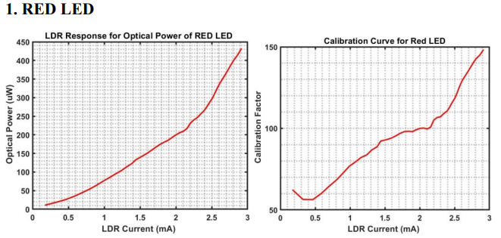
5.4 Result Analysis

Slide 23
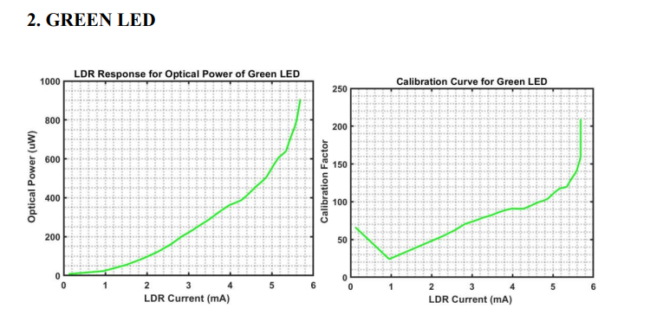
5.4 Result Analysis

Slide 24
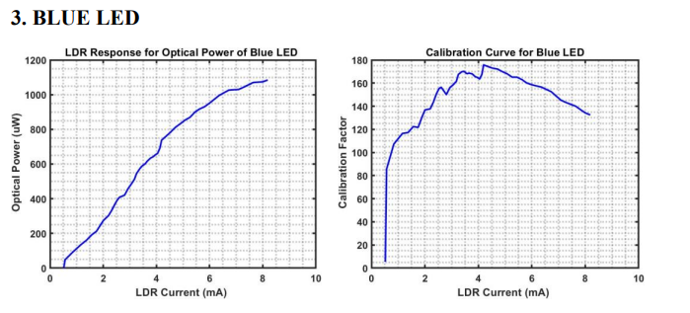
5.4 Result Analysis

Slide 25
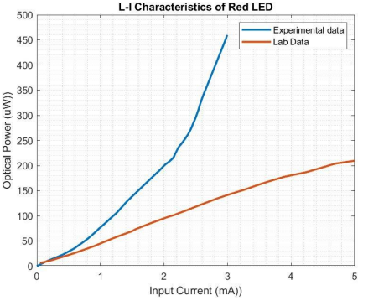
5.4 Result Analysis
Comparison between experimental data and lab data

Slide 26
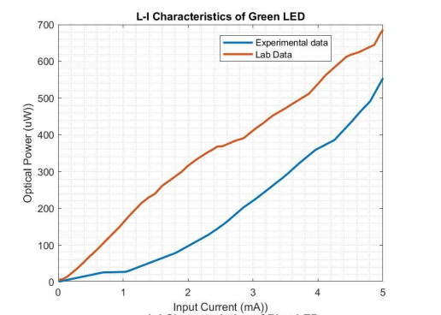
5.4 Result Analysis
Comparison between experimental data and lab data

Slide 27
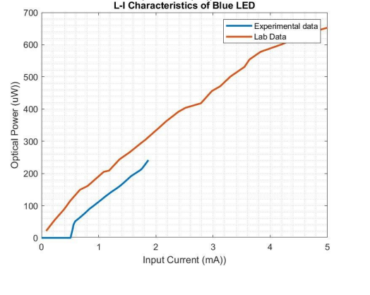
5.4 Result Analysis
Comparison between experimental data and lab data

Slide 28
5.4 Limitations of Tools (PO(e))
1. There was a problem encountered in Arduino analog sensing.
2. Arduino was needed. 2. LDR responsivity was an issue to handle.
3. Orientation of LED and LDR.

Slide 29
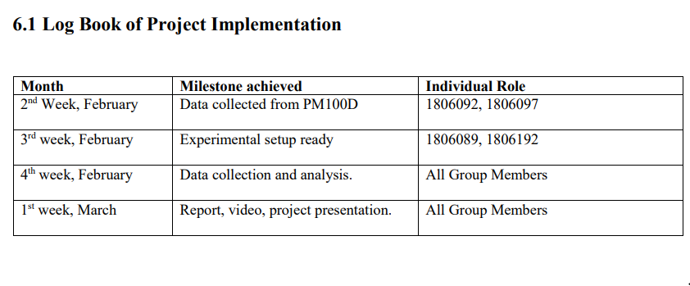
6.1 Individual Contribution of Each Member
Presented by: 1706XXX

Slide 30
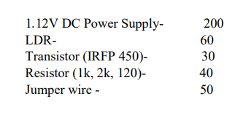
8. Project Management and Cost Analysis (PO(k))
Bill of Materials
Calculation of Per Unit Cost of Prototype
Total Cost – 2000 Tk by rounding

Slide 31
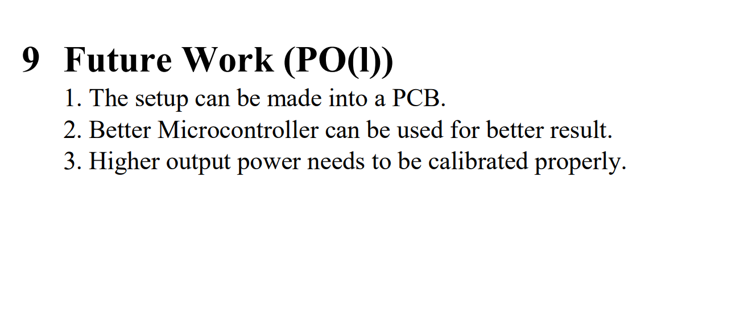

Slide 32
